Slide 1
Evaluation: The Phase Before Planning
STP Meeting
Wednesday, January 17, 2024

Slide 2
What most people “think” when they hear project lifecycle
Design
Right-of-Way & Utilities
Operations & Maintenance
Construction
Planning
Evaluation

Slide 3
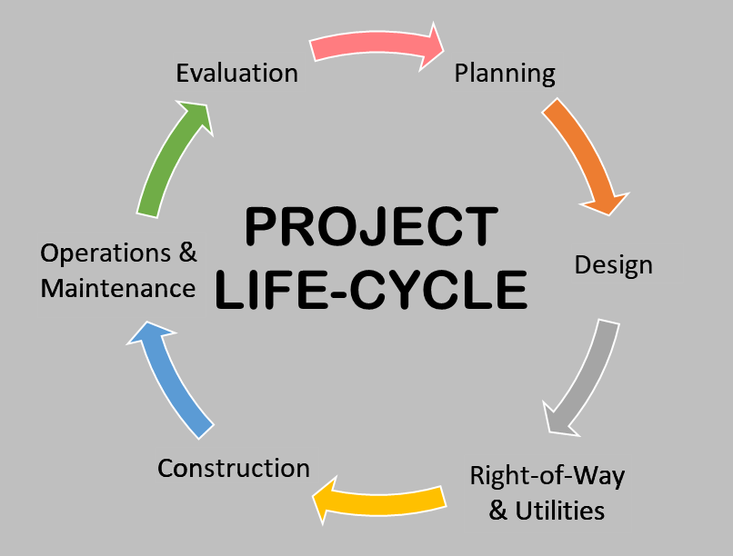
My view the project lifecycle

Slide 4
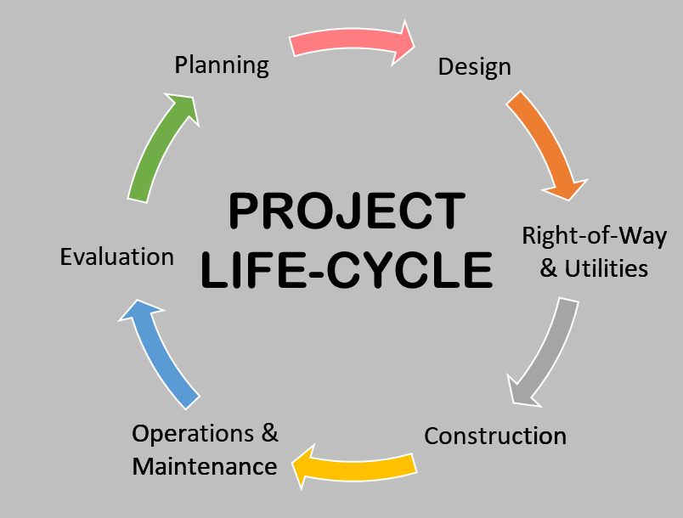
Even when people start visualizing a circle

Slide 5
Even when people start visualizing a circle

Slide 6
My view the project lifecycle

Slide 7
Today’s Outline
Evaluation of HSIP-funded Roadway Departure (RD) Corridors
What is an RD Corridor
Types of countermeasures
Evaluation results
Evaluation of HSIP-funded Restricted Crossing U-Turn (RCUT) Intersections
What is an RCUT Intersection and how do they operate
How RCUTs help drivers
Evaluation results

Slide 8
What is an RD Corridor
Target Facility: Rural, 2-lane, 50+ mph posted speed limit
Target Crash Type: Roadway Departure crashes (single vehicle, head-on, sideswipe opposite direction)
Typical Length: 4-12 miles, with 5-8 mile corridor lengths most common
RD Corridor projects have an avg cost of $250,000/mile to $400,000/mile
Major HSIP Initiative since 2013
Average Annual Funding Target: $21 – $30 Million

Slide 9
Types of Countermeasures
Widen and/or pave shoulders (to obtain up to 11’ lanes and 2’ paved shoulders)
Add centerline and/or edgeline rumble strips (if we have enough pavement width)
Roadside Regrading
Culvert pipe extensions and/or installing crashworthy headwalls
Improve signing and delineation
Superelevation and pavement cross slope improvements
Usually also requires regrading the roadside
Remove trees and/or trim tree canopy
Remove & replace substandard guardrail (especially end treatments)
Goal: keep all improvements within existing ROW

Slide 10
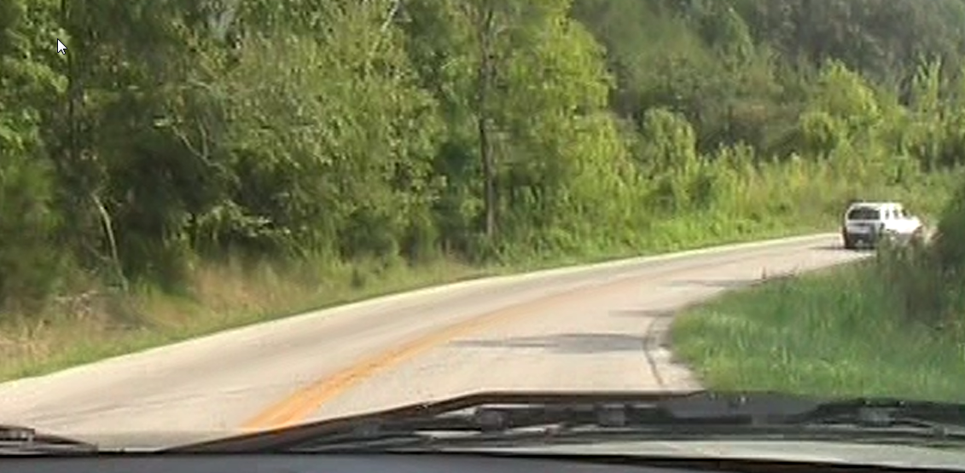
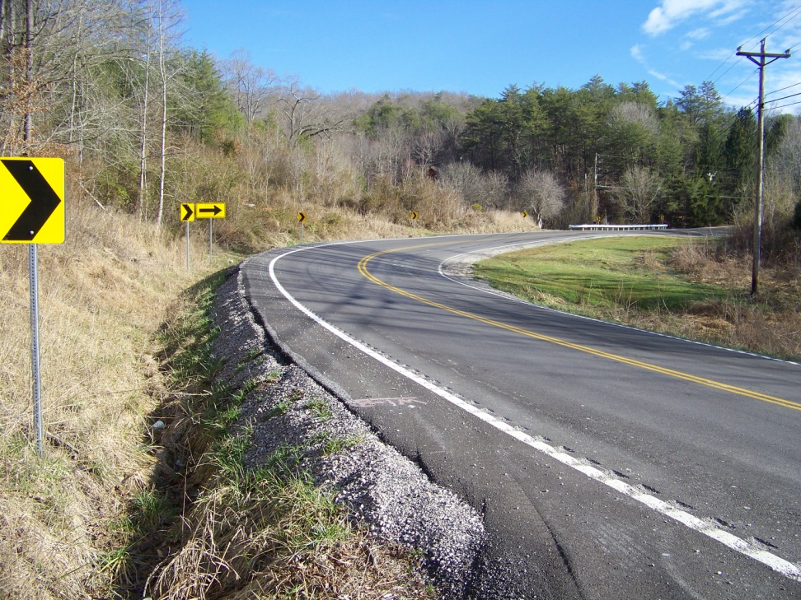
Improved delineation (curve signing)
Tree Removal
Roadside regrading (especially the inside of the curve for sight distance)
Pavement widening to obtain edgeline rumble strips and 2’ of paved shoulder

Slide 11
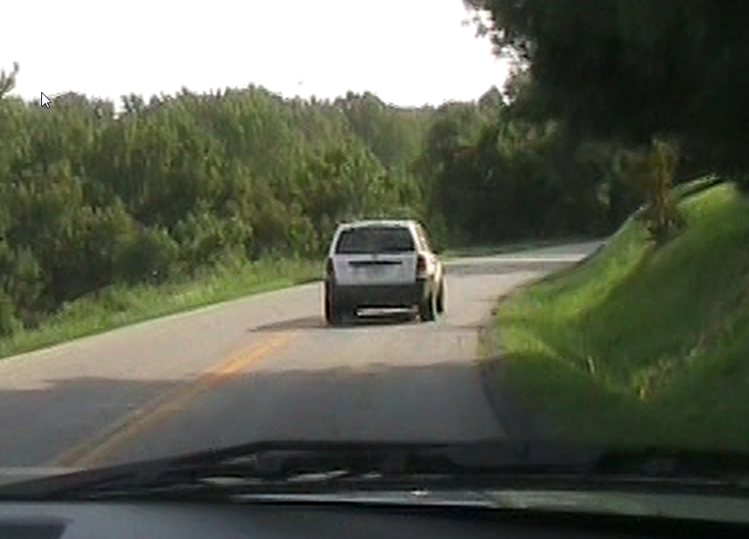
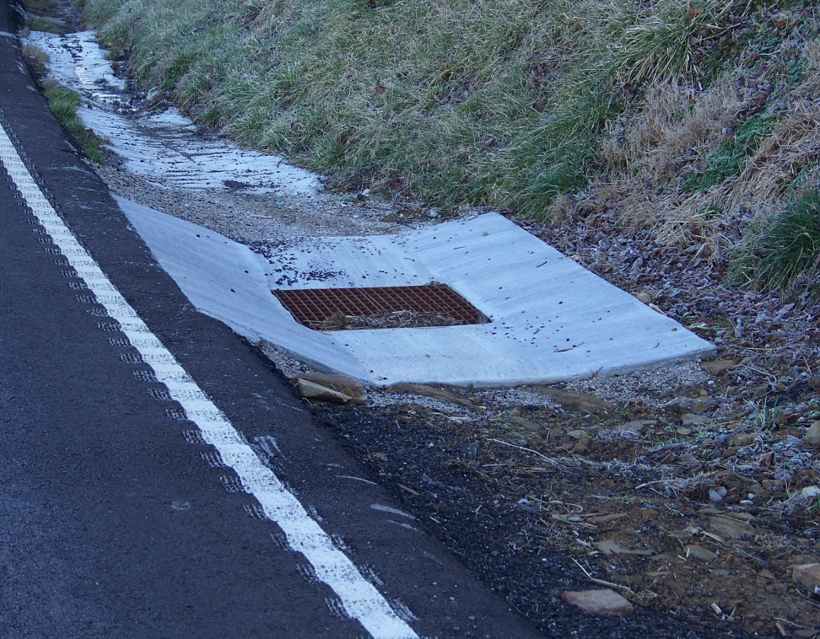
Added Drop Box Inlet to eliminate roadside hole
Roadside regrading (improve ditch flow to DBI)
Pavement widening to obtain edgeline rumble strips and 1’ of paved shoulder

Slide 12
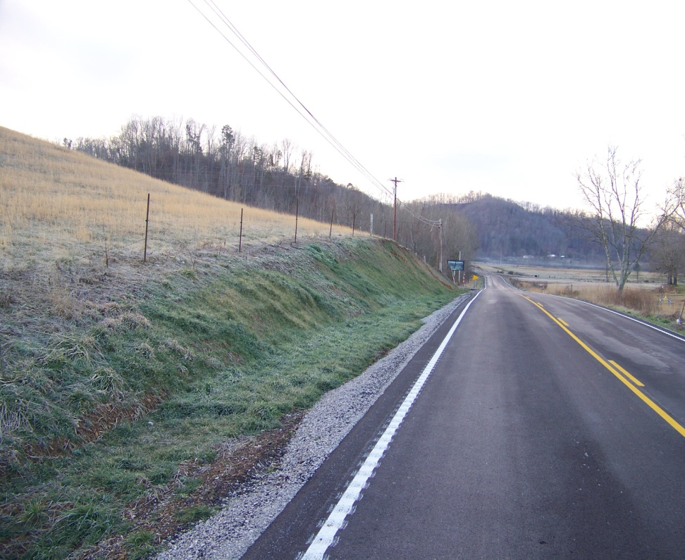
Pavement widening to obtain edgeline rumble strips and 1’ of paved shoulder
DGA wedge
Roadside Regrading

Slide 13
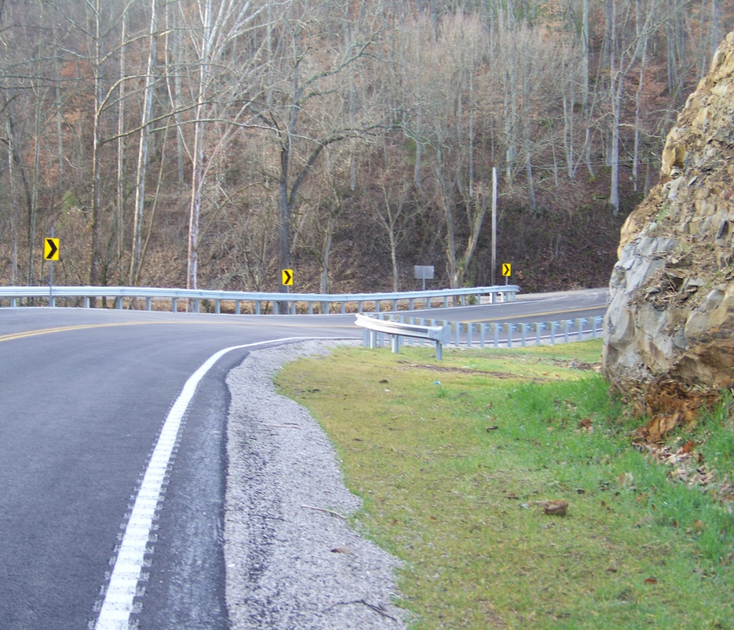
Pavement widening to obtain edgeline rumble strips and 1’ of paved shoulder
DGA wedge
Roadside Regrading
Hoe ram 3-4 ft from rock face to improve sight distance around curve
Improve delineation (curve signing)
Superelevation improvement
Remove & replace substandard guardrail

Slide 14
Targeted Guardrail End Treatments
Spearing (i.e. no end treatment)
Type 7 (i.e. a turndown end treatment)
“Dipping” Type 3 (i.e. a buried in backslope end treatment that “dips” below the near edge of pavement)
Breakaway Cable Terminals (i.e. BCTs – our old Type 4)

Slide 15
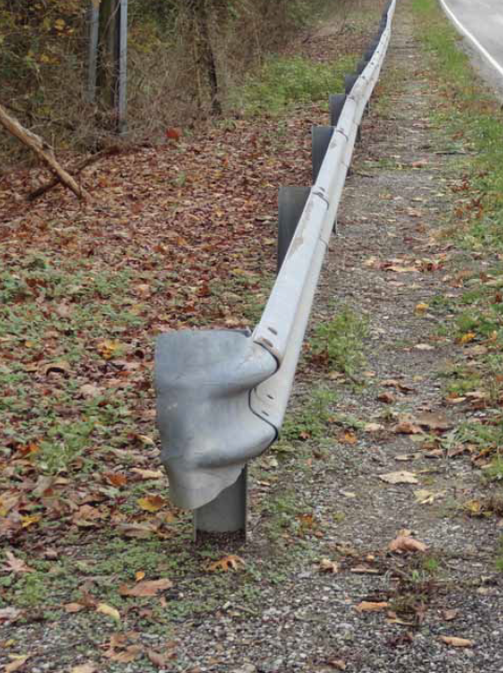
Spearing ends

Slide 16
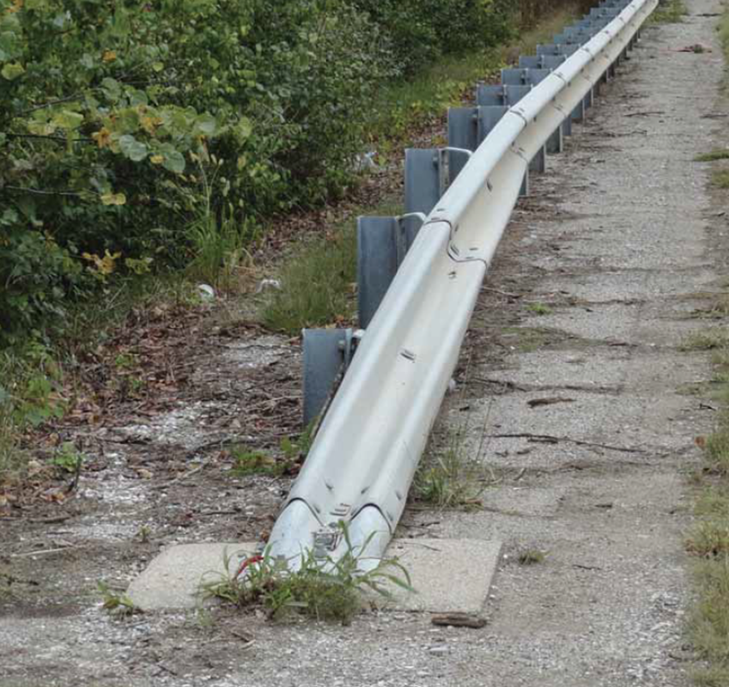
Type 7 turndown
can launch small/light vehicles airborne

Slide 17
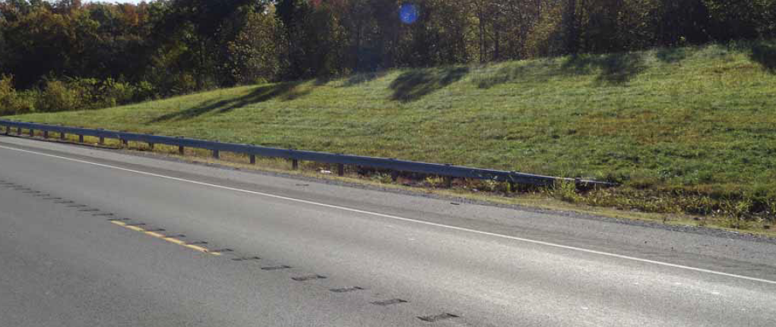
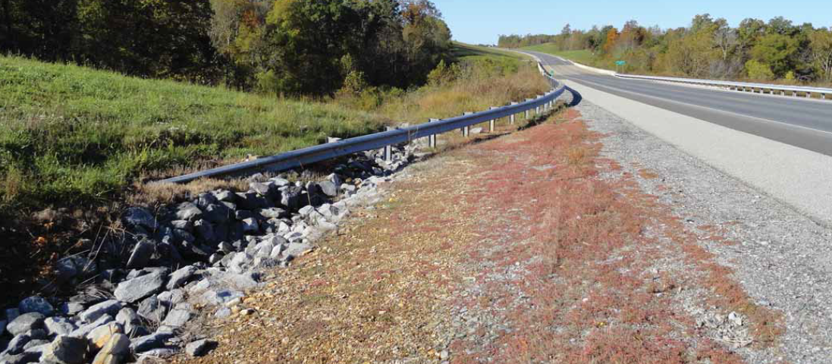
“Dipping” Type 3
can act like a Type 7 and launch errant vehicles airborne (and not just small/light vehicle)

Slide 18
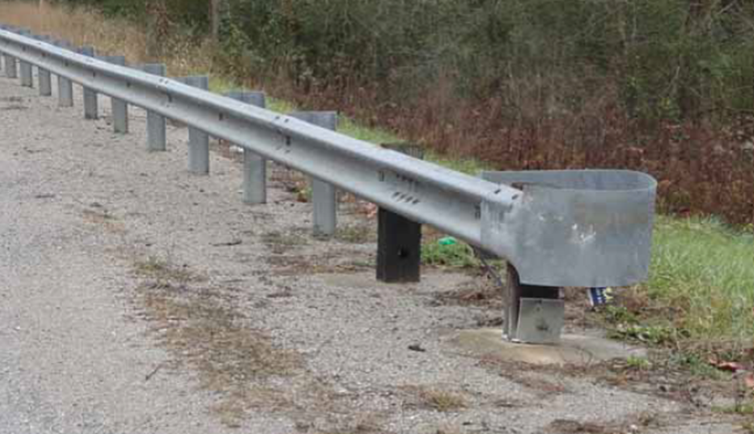
Breakaway Cable Terminals
aka BCTs
KYTC’s old Type 4 (what we had before the Type 4a)
can be hard to ID
what to look for:
first two posts are wood, set in concrete
37.5 ft long installed on a parabola
end of terminal has a large piece of metal that makes it resemble a boxing glove

Slide 19
RD Corridor Evaluation Results
42 RD Corridor projects evaluated
24 have 5 years of After data
13 have 4 years of After data
5 have 3 years of After data
1 project had a 10% increase in Fatal & Injury Crashes in the After period
1 project had no change in Fatal & Injury Crashes in the After period
40 projects varied between a 15% and 84% decrease in Fatal & Injury Crashes in the After period

Slide 20
RD Corridor Evaluation Results
If we look at the entire RD Corridor initiative:
Averaging a 52% decrease in Fatal & Injury Crashes
Averaging a 39% decrease in Property Damage Only Crashes
If we look at all 42 RD Corridor projects combined:
averaged 10.4 Fatal Crashes per Year in the Before period
averaged 6.0 Fatal Crashes per Year in the After period
a decrease of 42% in Fatal Crashes
averaged 41.0 Serious Injury Crashes per Year in the Before period
averaged 19.0 Serious Injury Crashes per Year in the After period
a decrease of 54% in Serious Injury Crashes

Slide 21
RD Corridor Evaluation Results
What does this tell us:
We can achieve major gains in safety if we:
Target routes that truly have poor safety performance (i.e. relatively high EECs)
Implement proven safety countermeasures
Keeping in mind that we don’t have to meet Green Book recommendations
Many times, just making whatever improvement we can within existing ROW will net significant gains
Think about how many miles of Rural, 2-Lane roadways we could improve if more of our projects averaged $250,000/mile to $400,000/mile

Slide 22
What is an RCUT Intersection
RCUT = Restricted Crossing U-Turn … OR … Reduced Conflict U-Turn
Sometimes referred to as a J-Turn
RCUTs can be unsignalized or signalized
A corridor of signalized RCUTs is referred to as a Superstreet

Slide 23
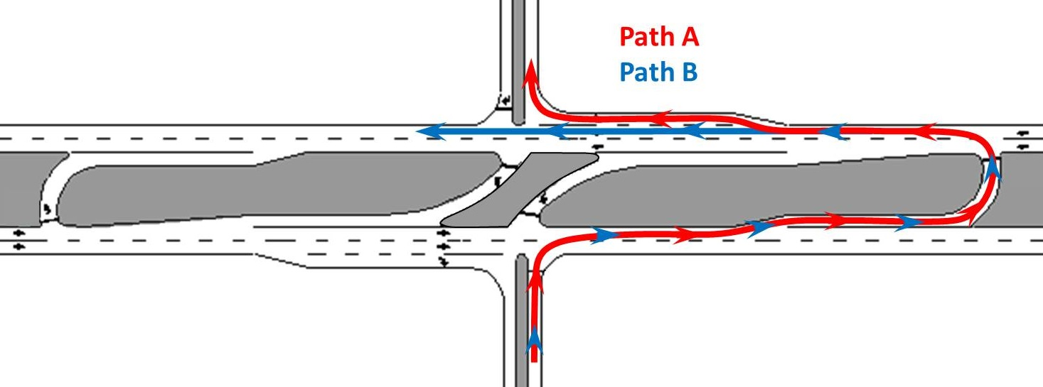
How does an RCUT operate
Mainline traffic interacts the same as a traditional intersection
All side street traffic must turn right and redirect at a nearby U-Turn

Slide 24
How do RCUTs help drivers?
By reducing conflict points
Traditional intersection: 32 Conflict Points
RCUT intersection: 14 Conflict Points (~56% fewer)
Fewer Conflict Points = Lower Driver Workload

Slide 25
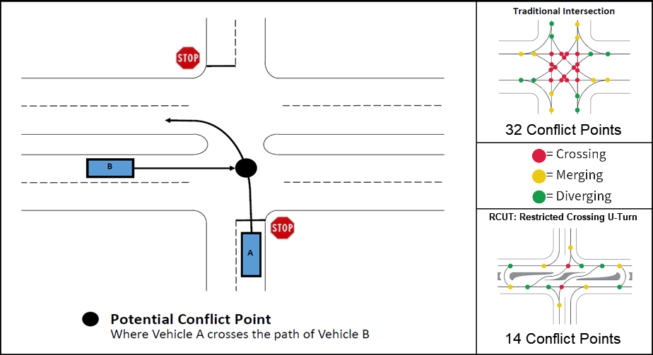
Notes:
If you’re not familiar, a conflict point is where two vehicles have the chance to crash into one another if one vehicle makes a mistake and does not yield the right of way to the other vehicle. It’s a little hard to see the conflict diagrams in the upper left and lower right corners, but a traditional intersection has 32 conflict points, whereas an RCUT intersection has 14 conflict points. What’s more, the red dots in the two conflict diagrams represent crossing conflict points… crossing conflict points are where a T-bone type crash can occur. As can be seen, a traditional intersection has a lot of red dot locations where a T-bone crash can occur, whereas an RCUT has very few red dot locations where a T-bone crash can occur.

Slide 26
Notes:
A little bit ago, I mentioned that fewer conflict points meant less driver workload. In case you’re not familiar with the term driver workload, here is a video that I think does a good job illustrating how fewer conflict points help drivers. On a busy road, drivers monitor conflict points from all directions. Too many conflict points make driving unpredictable and risky. Designs that reduce conflict points create a more predictable and less stressful experience for drivers.

Slide 27
RCUT Intersection Evaluation Results
15 RCUT Intersections evaluated
2 locations have 5 years of After data
2 locations have 4 years of After data
4 locations have 3 years of After data
7 locations have 2 years of After data
All 15 locations had a decrease in Fatal & Injury Crashes in the After period ranging from a 41% decrease to a 100% decrease
4 locations had an increase in Property Damage Only crashes ranging from a 39% increase to a 173% increase; all other locations saw a decrease
NOTE: the locations with a relatively high increase in PDO crashes have all experienced a decrease in Fatal & Injury Crashes between 73% to 100%

Slide 28
RCUT Intersection Evaluation Results
If we look at the entire RCUT initiative:
averaging a 76% decrease in Fatal & Injury Crashes
averaging a 23% decrease in Property Damage Only Crashes
approx. 30 Fatal and Injury Crashes are being saved per Year
(an estimated $10,965,000 per Year in Crash Costs saved)
approx. 20 Property Damage Only Crashes are being saved per Year
(an estimated $223,000 per Year in Crash Costs saved)
A total of $11,188,000 per Year in Crash Costs saved
In just 5 short years in the After period, we predict we’ll achieve a Benefit/Cost ratio of 8.8:1 … in 10 years, the B/C estimate is 17.6:1

Slide 29
RCUT Intersection Evaluation Results
What does this tell us:
The RCUT is a proven safety countermeasure
We need to look for opportunities to convert existing intersections to RCUTs
We need to start making the RCUT intersection the default intersection along multilane divided roadways

Slide 30
RCUT Intersection Evaluation Results
What does this tell us:
The RCUT is a proven safety countermeasure
We need to look for opportunities to convert existing intersections to RCUTs
We need to start making the RCUT intersection the default intersection along multilane divided roadways
On a related side note: along 2-lane, undivided roadways, we need to look for every opportunity to install roundabouts and starting making roundabouts the default intersection along 2-lane, undivided roadways

